Slide 1
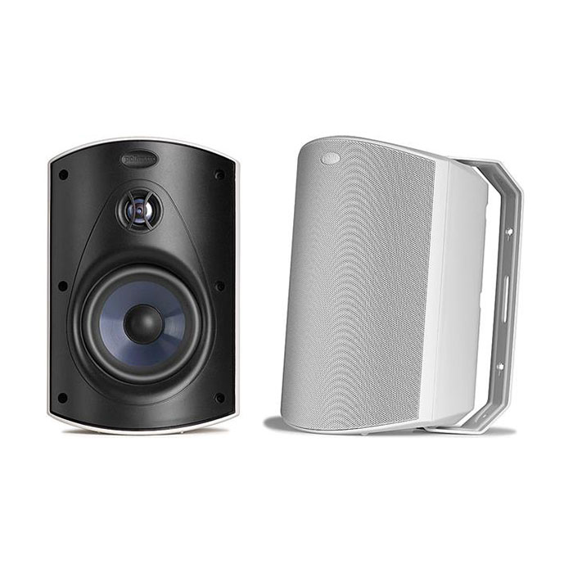
Outdoor Loud Speaker
Atrium4
Outdoor Speaker System
FEATURE
올 웨더 인증
스피드 록 마운팅 시스템
서라운드 시스템으로 설계 가능
SPECIFICATION
항목 | 세부내용
Total Frequency Response | 75Hz-25kHz
Recommended Power | 10-80W continuous
Impedance | Compatible w/ 8 Ohm outputs
Driver Complement | 4 1/2" (114mm) mineral filled Dynami Balance polymer cone, rubber surround, 3/4" (19mm) anodized aluminum dome tweeter w/ rubber surround and neodymium motor structure
Efficiency (dB 1w/1m) | 89dB
Cabinet material | Mineral filled polypropylene
Grille & Bracket material | Powder coated aluminum
Hardware | Brass or stainless steel
Terminals | Gold plated 5-way binding posts
Mounting Options | 180° Speed-Lock mounting
Color | Black or White
Dimensions (WxDxH) | 14.4 x 17.0 x 21.9cm
Weight | 1.63 kg (pair : 4.1kg)
경기도 성남시 분당구 판교로 723(분당테크노파크) B동 604-2호
TEL : 031-709-1061 / FAX : 031-709-1062

