Slide 1
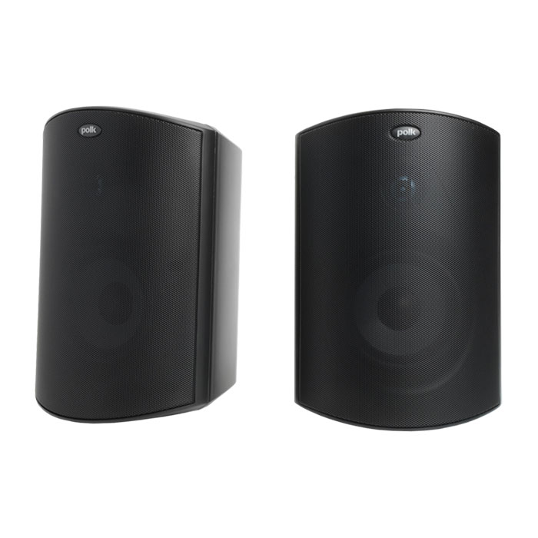
Outdoor Loud Speaker
Atrium6
Outdoor Speaker System
FEATURE
최악의 요소를 견딜 수 있도록 전천후 인증 및 방수 기능을 제공
Polk의 Dynamic Balance® 기술로 설계
서라운드 시스템으로 설계 가능
SPECIFICATION
항목 | 세부내용
Total Frequency Response | 50Hz-27kHz
Recommended Power | 10-100W continuous
Impedance | Compatible w/ 8 Ohm outputs
Driver Complement | 5 1/4" (133mm) Dynamic Balance aerated polypropylene cone, rubber surround, 1" (25mm) anodized aluminum dome tweeter w/ rubber surround and neodymium motor structure
Efficiency (dB 1w/1m) | 90dB
Cabinet material | Mineral filled polypropylene
Grille & Bracket material | Powder coated aluminum
Hardware | Brass or stainless steel
Terminals | Gold plated 5-way binding posts
Mounting Options | 180° Speed-Lock mounting
Color | Black
Dimensions (WxDxH) | 19.5 x 22.2 x 29.7 cm
Weight | 2.45 kg (pair :7.0kg)
경기도 성남시 분당구 판교로 723(분당테크노파크) B동 604-2호
TEL : 031-709-1061 / FAX : 031-709-1062

