Slide 1
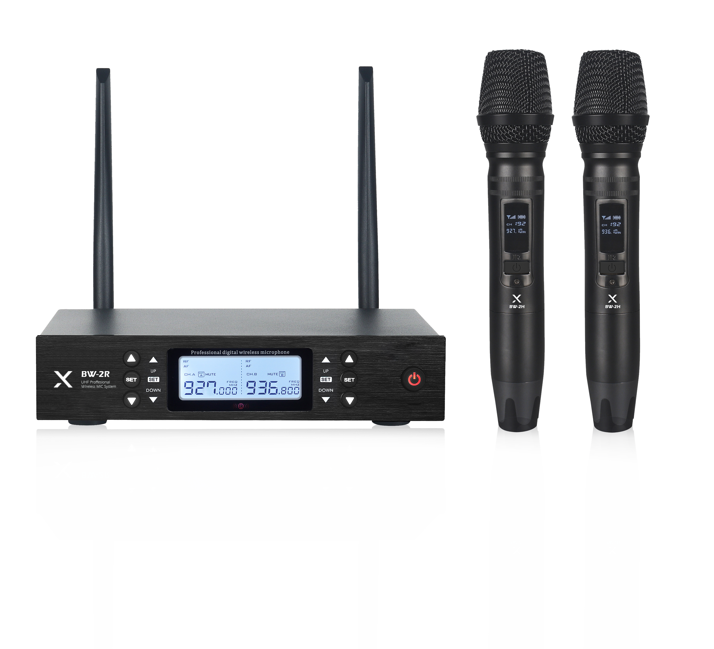
2CH Wireless Mic System
BW-2R
Professional Wireless MIC System
FEATURE
UHF 900MHz 가변형 2채널 무선 시스템
PLL 자동 채널 IR 방식
송·수신기 디스플레이 모니터링
선명한 음질과 신호 안정성 제공
SPECIFICATION
수신기(BW-2R) | 세부내용
Frequency Range | 925.0 ~ 937.5MHz
Receiver Way | Super heterodyne twice frequency conversion
Stray radiation | >80dB
Antenna Access | Unbalanced +4dB(1.25V)/5KΩ, Balanced +10dB(2.5V)/600Ω
Power supply | DC 11-16V (Rated 12V)
Size (WxDxH) | 210*42*145mm
송신기 (BW-2H) | 세부내용
Frequency Range | 925.0 ~ 937.5MHz
MIC Pattern | Cardioid
Modulation Mode | FM
Frequency Bandwidth | 60MHz
Frequency Quantity | 200 available
Frequency Stability | ±0.005%
Harmonic radiation | > 110dB
Max Deviation | +45KHz
S/N Ratio Response | >105dB
T.H.D distortion | <0.·5%
Output Power | 5~10MW
Size (WxDxH) | 230*47mm
경기도 성남시 분당구 판교로 723(분당테크노파크) B동 505호
TEL : 031-8011-0388 / FAX : 031-709-1062

