Slide 1
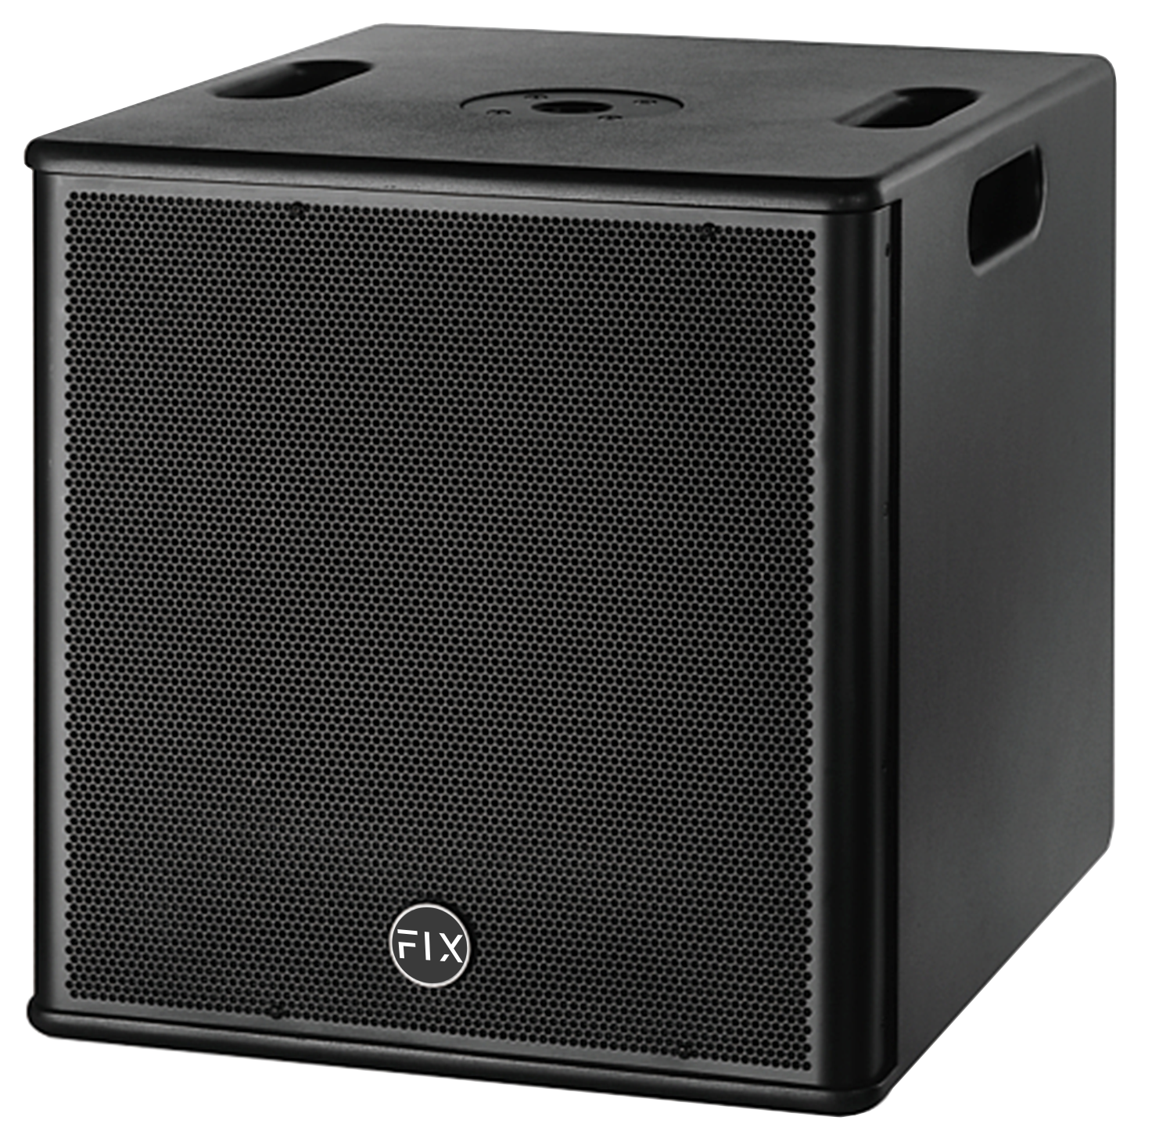
Mini Active Line Array Subwoofer Speaker
CPA12SA
Professional Mini Active Line Array Subwoofer Speaker
FEATURE
• 12＂ Mini DSP-Controlled Active Line Array Subwoofer
• 단일 12인치 액티브 서브우퍼 75mm 보이스 코일 탑재
• 효율 파워 앰프 모듈(DSP 포함)을 채용하여 강력한 출력 전력
• CPA205와 매치하여 사용
SPECIFICATION
항목 | 세부내용
Frequency Response | 45Hz-500Hz
Sensitivity(1W@1m) | 101dB
Nominal Impedance: | 8Ω
Rated Power | 400W AES, 1600Wpeak
LF Driver | 1×12＂(300mm)/3＂voice coil LF
Maximum SPL | 122dB continuous, 128dB peak
Connectors | XLR IN/LINK
Net Weight | 21kg
Dimensions(W x D x H) | 430mm×480mm×450mm
Amplifier Circuity | Class D
Amplfier Power | 600W
Protection | DC protection, short circuit protection, overheat protection, input/output overload protection, soft startup protection, overvoltage protection, undervoltage protection.
DSP Processor | 96KHz signal sampling frequency, 24 bit precision
경기도 성남시 분당구 판교로 723(분당테크노파크) B동 604-2호
TEL : 031-709-1061 / FAX : 031-709-1062

