Slide 1
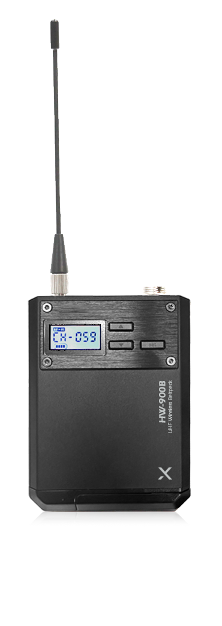
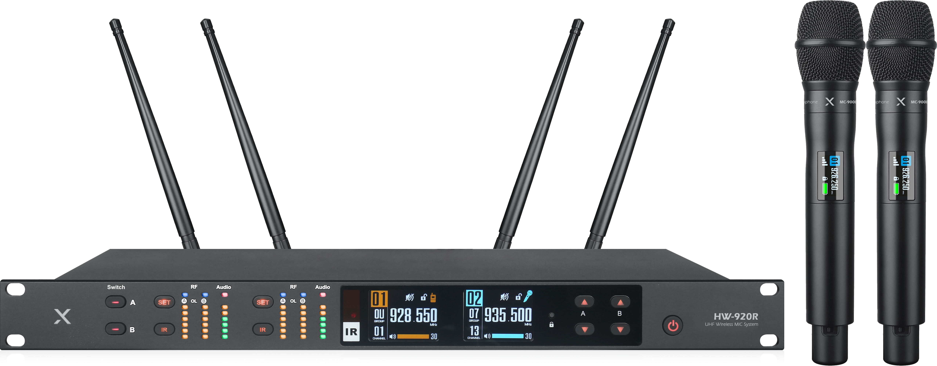
Wireless 2CH Receiver
HW-920
Professional Wireless MIC System
FEATURE
핸드마이크와 벨트팩 동시연결 스위칭 기능
스펙트럼 아날라이저 탑재
고품질 유닛 탑재
노이즈 제거 및 안정적 통신 유지
TFT LCD 디스플레이 탑재
SPECIFICATION
항목 | 수신기
Frequency range | 925.0 ~ 937.5MHz
Frequency stability | 0.002PPM
Receiving sensitivity | -100dB
Tone frequency response | 60hz-18khz (3dB)
Harmonic distortion | < 0.5%
Signal to noise ratio | ＞105dB
Dynamic range | 105dB
Maximum frequency offset | ±48KHz
Stray suppression | ≥75dB
Audio output | balanced output and unbalanced output
Power supply | 12-18V DC/1000mA
Dimensions | 210 * 44 * 150mm
Net weight | 526 g
항목 | 송신기
Frequency range | 925.0 ~ 937.5MHz
Frequency stability | 0.002PPM
Receiving sensitivity | -100dB
Tone frequency response | 60hz-18khz (3dB)
Harmonic distortion | < 0.5%
Signal to noise ratio | ＞105dB
Dynamic range | 105dB
Maximum frequency offset | ±48KHz
Stray suppression | ≥75dB
Audio output | balanced output and unbalanced output
Power supply | 12-18V DC/1000mA
www.voatek.com
e-mail : voatek@naver.com
Tel : 031-8011-0388

