Slide 1

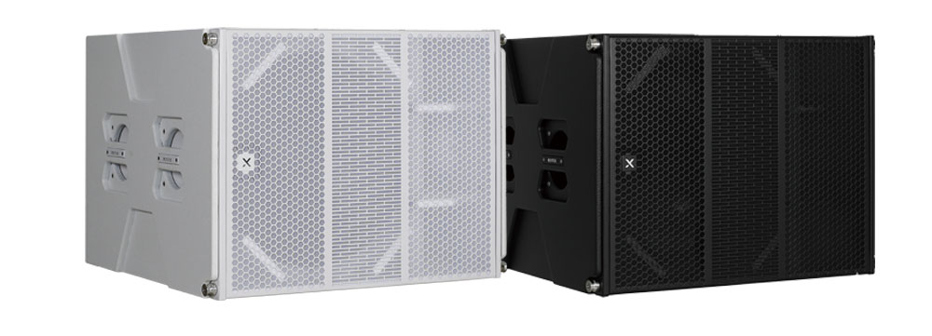

Line Array Speaker
LX-118S+
Professional Line Array Speaker System
FEATURE
18” 네오디뮴 드라이버 우퍼의 강력한 저음 재생
800W RMS, 최대 138dB SPL 출력
라인어레이와 조화를 이루는 묵직한 저음 보강
러시아산 벗지 우드로 제작하여 견고함
SPECIFICATION
항목 | 세부내용
Frequency Response | 35Hz – 200Hz (±5dB)
Transducer Configuration | 1 × 18" (100mm voice coil)
Power Handling | 800W (RMS) / 1600W (Program)
Sensitivity (1W/1m) | 97dB
Maximum SPL | 138dB
Nominal Impedance | 8Ω
Connector | 2 × NL4 Speakon
Suspension Hardware | Dedicated AM18S hardware, 1 × KARA18S support frame, 1 × base support
Enclosure Material | 18mm plywood with eco-friendly, wear-resistant black water-based paint
Dimensions (W × H × D) | 810 × 544 × 700mm
Recommended Applications | Outdoor performances / Hotels / Conferences / Multipurpose halls / Lounges
경기도 성남시 분당구 판교로 723(분당테크노파크) B동 604-2호
TEL : 031-709-1061 / FAX : 031-709-1062
www.voatek.com
e-mail : voatek@naver.com
Tel : 031-8011-0388

