Slide 1
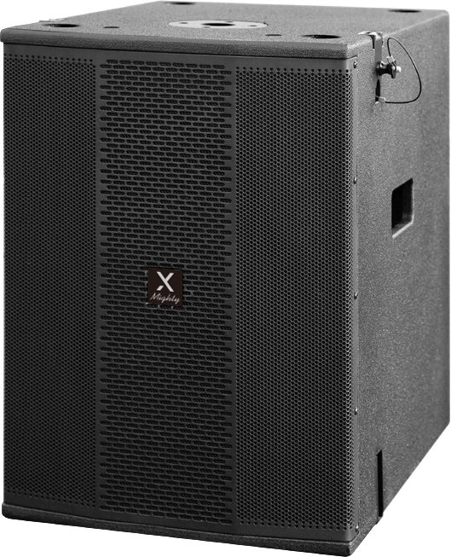
Active Line Array Subwoofer Speaker
Mighty5 Sub
Professional Active Line Array Speaker System
FEATURE
LCD 디스플레이 화면을 통해 모든 파라미터 직접 제어 가능
프리셋 설정 포함
SPECIFICATION
항목 | 세부내용
Inputs/ Output | 1*XLR input/ 1*XLR Link or Xover output
Power output | 700W RMS
Power input | 220-240V~50/60Hz
Features | Class D + Switching power design/ LED power, signal, clip indicator/ Xoverdesign for satellite ( 90Hz or 120Hz)/ Phase switchable(0/180)/ LCD with multiple DSP(Digital Signal Processing)
Type | Acitve Bandpass subwoofer
Frequency response | 60-150Hz
Impedance | 8 ohm
Max output SPL(1m) | 124dB (at max amp output)
Driver | 2'' subwoofer, 3'' vc84 Oz
Grill | 1.2mm steel
Pole | Mighty5 screw pole
Size(WxDxH) | 380 ×520 ×526mm
Weight : | 32kg
경기도 성남시 분당구 판교로 723(분당테크노파크) B동 604-2호
TEL : 031-709-1061 / FAX : 031-709-1062

