Slide 1
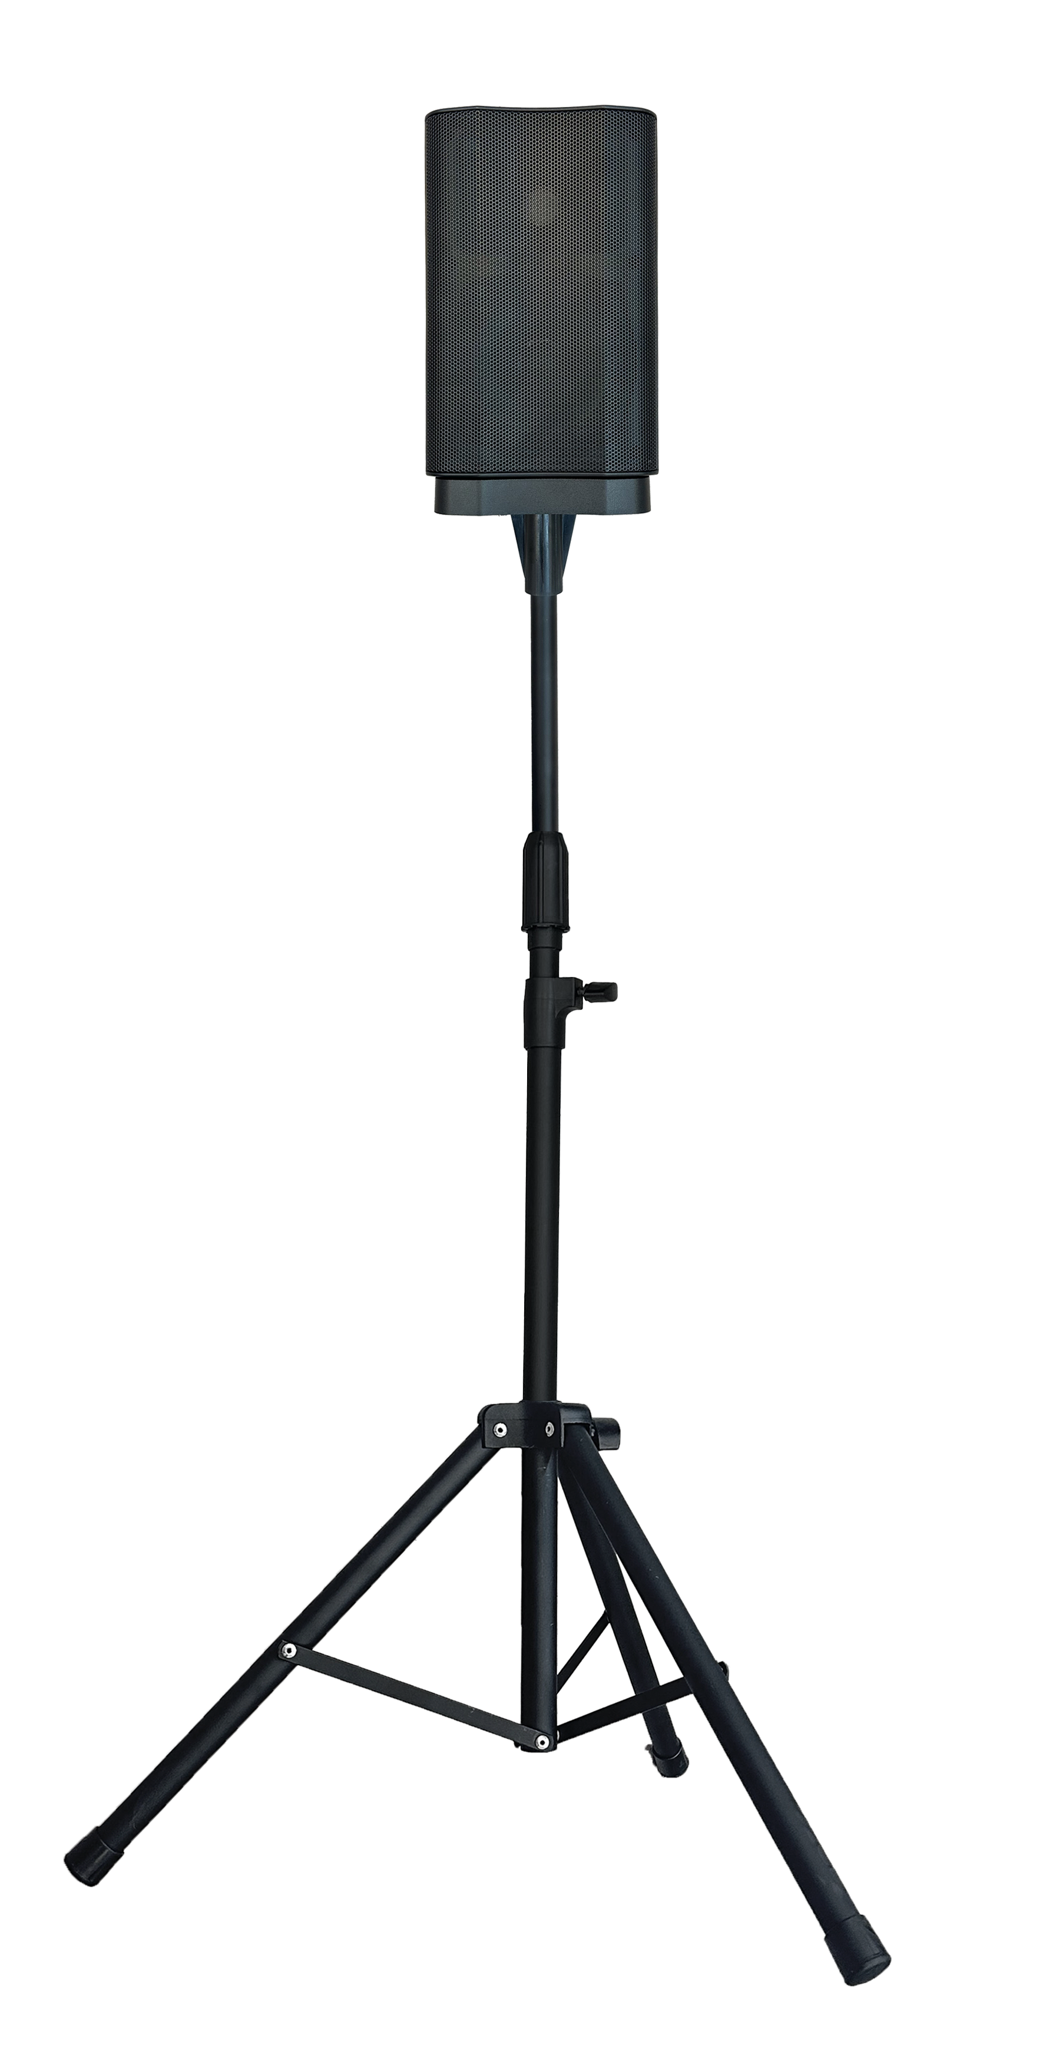
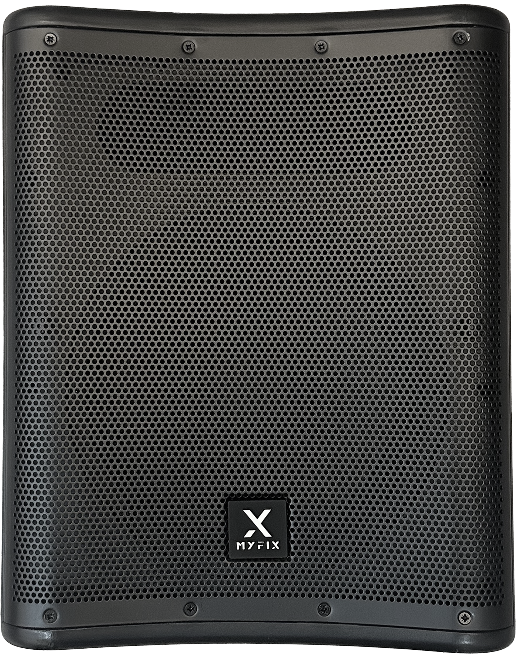
Active Bluetooth Speaker
Stage2
Professional Active Bluetooth Speaker System
FEATURE
• 1.5인치 스테레오 + 10인치 우퍼로 구성
• Bluetooth(TWS), DSP Control, AUX-IN 기능
• 다기능홀, 공연예술센터, 강당, 회의실에 적용가능
SPECIFICATION
항목 | 세부내용
Max. SPL | 122dB
Frequency response (±10dB) | 55 Hz - 20 kHz
Power amplifier output | Class D Bi-amp 800W PEAK, 200W RMS (100W column + 100W sub)
Crossover frequency | 180Hz
Midrange Woofer | 2*(1*5" +1"HF)
Input | 10" 2.0VC 40OZ
Bass Woofer | Ch1&Ch2 with individual Volume, Treble, Bass and Reverb(on/off switch) Ch3 AUX&BT switch with level and Reverb Master volume control
Output | 1* XLR MIX OUT Output
Enclosure Material | Sub:ABS Column: ABS Connection:ABS
Size (W*H*D) | Culumn : 147*227*144/ Woofer : 350*440*425
경기도 성남시 분당구 판교로 723(분당테크노파크) B동 604-2호
TEL : 031-709-1061 / FAX : 031-709-1062

